Slide 1
Mining Sequential Patterns
Slides are adapted from
Introduction to Data Mining
by
Tan, Steinbach, Kumar
© Tan,Steinbach, Kumar Introduction to Data Mining 4/18/2004

Slide 2
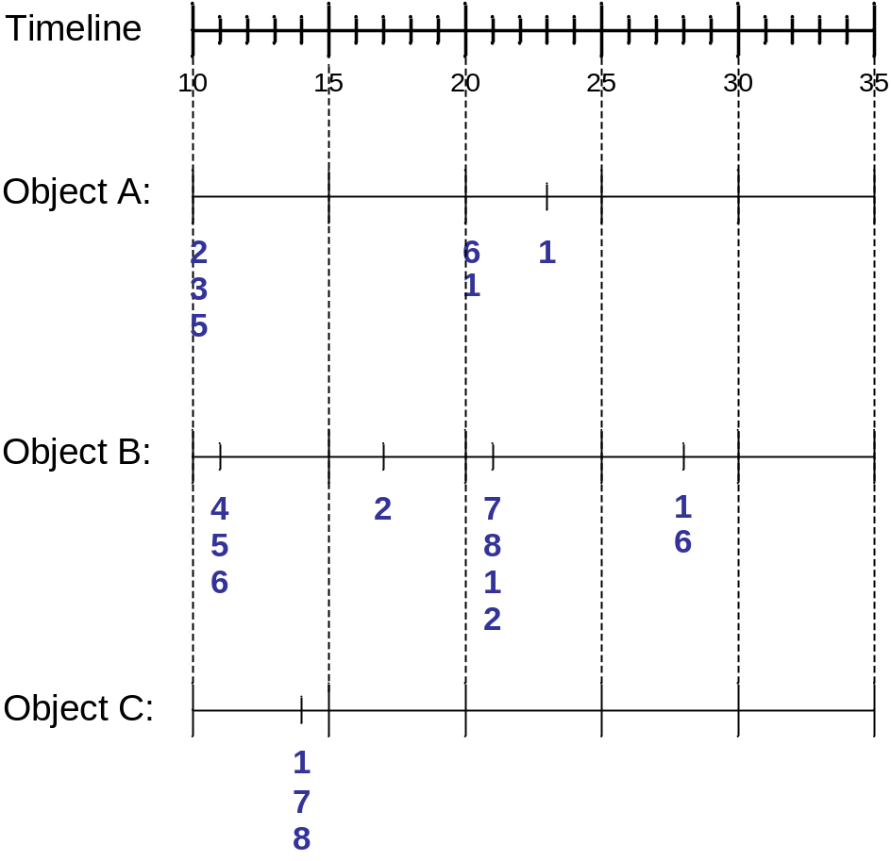
Sequence Data
Sequence Database:
Object
Timestamp
Events
A
10
2, 3, 5
A
20
6, 1
A
23
1
B
11
4, 5, 6
B
17
2
B
21
7, 8, 1, 2
B
28
1, 6
C
14
1, 8, 7

Slide 3
Examples of Sequence Data
Sequence Database | Sequence | Element (Transaction) | Event (Item)
Customer | Purchase history of a given customer | A set of items bought by a customer at time t | Books, diary products, CDs, etc
Web Data | Browsing activity of a particular Web visitor | A collection of files viewed by a Web visitor after a single mouse click | Home page, index page, contact info, etc
Event data | History of events generated by a given sensor | Events triggered by a sensor at time t | Types of alarms generated by sensors
Genome sequences | DNA sequence of a particular species | An element of the DNA sequence | Bases A,T,G,C
Element (Transaction)
Event
(Item)
E1
E2
E1
E3
E2
E2
E3
E4
Sequence

Slide 4
Formal Definition of a Sequence
A sequence is an ordered list of elements (transactions)
  s = < e₁ e₂ e₃ … >
  Each element contains a collection of events (items)
  e_{i} = {i₁, i₂, …, i_{k}}
  Each element is attributed to a specific time or location
Length of a sequence, |s|, is given by the number of elements of the sequence
A k-sequence is a sequence that contains k events (items)

Slide 5
Examples of Sequence
Web sequence
  < {Homepage} {Electronics} {Digital Cameras} {Canon Digital Camera} {Shopping Cart} {Order Confirmation} {Return to Shopping} >
Sequence of initiating events causing the nuclear accident at 3-mile Island:
  < {clogged resin} {outlet valve closure} {loss of feedwater}
  {condenser polisher outlet valve shut} {booster pumps trip}
  {main waterpump trips} {main turbine trips} {reactor pressure increases}>
Sequence of books checked out at a library:
  <{Fellowship of the Ring} {The Two Towers} {Return of the King}>

Slide 6
Formal Definition of a Subsequence
A sequence <a₁ a₂ … a_{n}> is contained in another sequence <b₁ b₂ … b_{m}> (m ≥ n) if there exist integers
i₁ < i₂ < … < i_{n} such that a₁ ⊆ b_{i1} , a₂ ⊆ b_{i1}, …, a_{n} ⊆ b_{in}
The support of a subsequence w is defined as the fraction of data sequences that contain w
A sequential pattern is a frequent subsequence (i.e., a subsequence whose support is ≥ minsup)
Data sequence | Subsequence | Contain?
< {2,4} {3,5,6} {8} > | < {2} {3,5} > | Yes
< {1,2} {3,4} > | < {1} {2} > | No
< {2,4} {2,4} {2,5} > | < {2} {4} > | Yes

Slide 7
Sequential Pattern Mining: Definition
Given:
  a database of sequences
  a user-specified minimum support threshold, minsup
Task:
  Find all subsequences with support ≥ minsup

Slide 8
What Is Sequential Pattern Mining?
Given a set of sequences, find the complete set of frequent subsequences
A sequence : < (ef) (ab) (df) c b >
A sequence database
SID | sequence
10 | <a(abc)(ac)d(cf)>
20 | <(ad)c(bc)(ae)>
30 | <(ef)(ab)(df)cb>
40 | <eg(af)cbc>
An element may contain a set of items.
Items within an element are unordered
and we list them alphabetically.
<a(bc)dc> is a subsequence of <a(abc)(ac)d(cf)>
Given support threshold min_sup =2, <(ab)c> is a sequential pattern

Slide 9
Challenges on Sequential Pattern Mining
A huge number of possible sequential patterns are hidden in databases
A mining algorithm should
  find the complete set of patterns, when possible, satisfying the minimum support (frequency) threshold
  be highly efficient, scalable, involving only a small number of database scans
  be able to incorporate various kinds of user-specific constraints

Slide 10
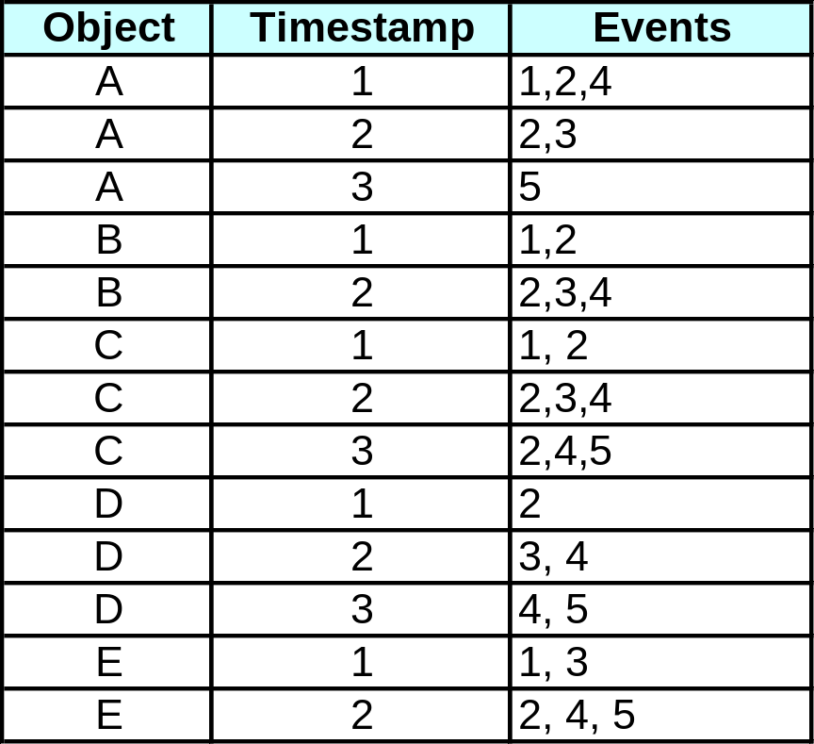
Sequential Pattern Mining: Example
Minsup = 50%
Examples of Frequent Subsequences:
< {1,2} > s=60%
< {2,3} > s=60%
< {2,4}> s=80%
< {3} {5}> s=80%
< {1} {2} > s=80%
< {2} {2} > s=60%
< {1} {2,3} > s=60%
< {2} {2,3} > s=60%
< {1,2} {2,3} > s=60%

Slide 11
Studies on Sequential Pattern Mining
Concept introduction and an initial Apriori-like algorithm
  R. Agrawal & R. Srikant. “Mining sequential patterns,” ICDE’95
GSP—An Apriori-based, influential mining method (developed at IBM Almaden)
  R. Srikant & R. Agrawal. “Mining sequential patterns: Generalizations and performance improvements,” EDBT’96
From sequential patterns to episodes (Apriori-like + constraints)
  H. Mannila, H. Toivonen & A.I. Verkamo. “Discovery of frequent episodes in event sequences,” Data Mining and Knowledge Discovery, 1997
Mining sequential patterns with constraints
  M.N. Garofalakis, R. Rastogi, K. Shim: SPIRIT: Sequential Pattern Mining with Regular Expression Constraints. VLDB 1999

Slide 12
Extracting Sequential Patterns
Given n events: i₁, i₂, i₃, …, i_{n}
Candidate 1-subsequences:
    <{i₁}>, <{i₂}>, <{i₃}>, …, <{i_{n}}>
Candidate 2-subsequences:
    <{i₁, i₂}>, <{i₁, i₃}>, …, <{i₁} {i₁}>, <{i₁} {i₂}>, …, <{i_{n-1}} {i_{n}}>
Candidate 3-subsequences:
    <{i₁, i₂ , i₃}>, <{i₁, i₂ , i₄}>, …, <{i₁, i₂} {i₁}>, <{i₁, i₂} {i₂}>, …,
    <{i₁} {i₁ , i₂}>, <{i₁} {i₁ , i₃}>, …, <{i₁} {i₁} {i₁}>, <{i₁} {i₁} {i₂}>, …

Slide 13
A Basic Property of Sequential Patterns: Apriori
A basic property: Apriori (Agrawal & Sirkant’94)
  If a sequence S is not frequent
  Then none of the super-sequences of S is frequent
  E.g, <hb> is infrequent → so do <hab> and <(ah)b>
Seq. ID
Sequence
Given support threshold min_sup =2
10
<(bd)cb(ac)>
20
<(bf)(ce)b(fg)>
30
<(ah)(bf)abf>
40
<(be)(ce)d>
50
<a(bd)bcb(ade)>

Slide 14
Generalized Sequential Pattern (GSP)
Step 1:
  Make the first pass over the sequence database D to yield all the 1-element frequent sequences
Step 2:
Repeat until no new frequent sequences are found
  Candidate Generation:
    Merge pairs of frequent subsequences found in the (k-1)th pass to generate candidate sequences that contain k items
  Candidate Pruning:
    Prune candidate k-sequences that contain infrequent (k-1)-subsequences
  Support Counting:
    Make a new pass over the sequence database D to find the support for these candidate sequences
  Candidate Elimination:
    Eliminate candidate k-sequences whose actual support is less than minsup

Slide 15
Finding Length-1 Sequential Patterns
Examine GSP using an example
Initial candidates: all singleton sequences
  <a>, <b>, <c>, <d>, <e>, <f>, <g>, <h>
Scan database once, count support for candidates
Cand | Sup
<a> | 3
<b> | 5
<c> | 4
<d> | 3
<e> | 3
<f> | 2
<g> | 1
<h> | 1
min_sup =2
Seq. ID
Sequence
10
<(bd)cb(ac)>
20
<(bf)(ce)b(fg)>
30
<(ah)(bf)abf>
40
<(be)(ce)d>
50
<a(bd)bcb(ade)>

Slide 16
Candidate Generation
Base case (k=2):
  Merging two frequent 1-sequences <{i₁}> and <{i₂}> will produce two candidate 2-sequences: <{i₁} {i₂}> and <{i₁ i₂}>
General case (k>2):
  A frequent (k-1)-sequence w₁ is merged with another frequent
  (k-1)-sequence w₂ to produce a candidate k-sequence if the subsequence obtained by removing the first event in w₁ is the same as the subsequence obtained by removing the last event in w₂
    The resulting candidate after merging is given by the sequence w₁ extended with the last event of w₂.
      If the last two events in w₂ belong to the same element, then the last event in w₂ becomes part of the last element in w₁
      Otherwise, the last event in w₂ becomes a separate element appended to the end of w₁

Slide 17
Candidate Generation Examples
Merging the sequences
w₁=<{1} {2 3} {4}> and w₂ =<{2 3} {4 5}>
will produce the candidate sequence < {1} {2 3} {4 5}> because the last two events in w₂ (4 and 5) belong to the same element
Merging the sequences
w₁=<{1} {2 3} {4}> and w₂ =<{2 3} {4} {5}>
will produce the candidate sequence < {1} {2 3} {4} {5}> because the last two events in w₂ (4 and 5) do not belong to the same element
We do not have to merge the sequences
w₁ =<{1} {2 6} {4}> and w₂ =<{1} {2} {4 5}>
to produce the candidate < {1} {2 6} {4 5}> because if the latter is a viable candidate, then it can be obtained by merging w₁ with
< {2 6} {45}>

Slide 18
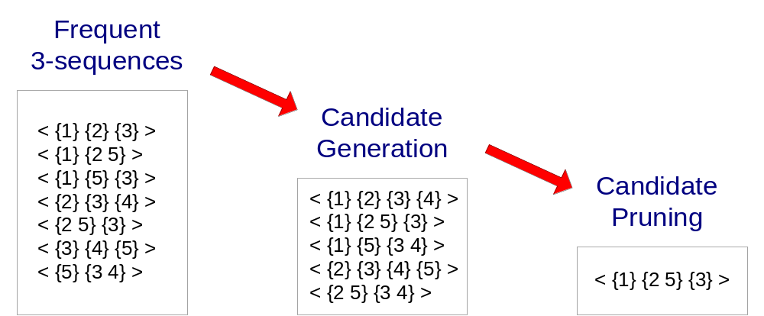
GSP Example

Slide 19
Generating Length-2 Candidates
 | <a> | <b> | <c> | <d> | <e> | <f>
<a> | <aa> | <ab> | <ac> | <ad> | <ae> | <af>
<b> | <ba> | <bb> | <bc> | <bd> | <be> | <bf>
<c> | <ca> | <cb> | <cc> | <cd> | <ce> | <cf>
<d> | <da> | <db> | <dc> | <dd> | <de> | <df>
<e> | <ea> | <eb> | <ec> | <ed> | <ee> | <ef>
<f> | <fa> | <fb> | <fc> | <fd> | <fe> | <ff>
51 length-2
Candidates
 | <a> | <b> | <c> | <d> | <e> | <f>
<a> |  | <(ab)> | <(ac)> | <(ad)> | <(ae)> | <(af)>
<b> |  |  | <(bc)> | <(bd)> | <(be)> | <(bf)>
<c> |  |  |  | <(cd)> | <(ce)> | <(cf)>
<d> |  |  |  |  | <(de)> | <(df)>
<e> |  |  |  |  |  | <(ef)>
<f>
Without Apriori property,
8*8+8*7/2=92 candidates
Apriori prunes
44.57% candidates

Slide 20
Finding Length-2 Sequential Patterns
Scan database one more time, collect support count for each length-2 candidate
There are 19 length-2 candidates which pass the minimum support threshold
  They are length-2 sequential patterns

Slide 21
Generating Length-3 Candidates and Finding Length-3 Patterns
Generate Length-3 Candidates
  Self-join length-2 sequential patterns
    Based on the Apriori property
    <ab>, <aa> and <ba> are all length-2 sequential patterns → <aba> is a length-3 candidate
    <(bd)>, <bb> and <db> are all length-2 sequential patterns → <(bd)b> is a length-3 candidate
  46 candidates are generated
Find Length-3 Sequential Patterns
  Scan database once more, collect support counts for candidates
  19 out of 46 candidates pass support threshold

Slide 22
The GSP Mining Process
5th scan: 1 cand. 1 length-5 seq. pat.
<(bd)cba>
Cand. cannot pass sup. threshold
4th scan: 8 cand. 6 length-4 seq. pat.
<abba> <(bd)bc> …
Cand. not in DB at all
3rd scan: 46 cand. 19 length-3 seq. pat. 20 cand. not in DB at all
<abb> <aab> <aba> <baa> <bab> …
2nd scan: 51 cand. 19 length-2 seq. pat. 10 cand. not in DB at all
<aa> <ab> … <af> <ba> <bb> … <ff> <(ab)> … <(ef)>
1st scan: 8 cand. 6 length-1 seq. pat.
<a> <b> <c> <d> <e> <f> <g> <h>
Seq. ID
Sequence
min_sup =2
10
<(bd)cb(ac)>
20
<(bf)(ce)b(fg)>
30
<(ah)(bf)abf>
40
<(be)(ce)d>
50
<a(bd)bcb(ade)>

Slide 23
The GSP Algorithm
Take sequences in form of <x> as length-1 candidates
Scan database once, find F₁, the set of length-1 sequential patterns
Let k=1; while F_{k} is not empty do
  Form C_{k+1}, the set of length-(k+1) candidates from F_{k};
  If C_{k+1} is not empty, scan database once, find F_{k+1}, the set of length-(k+1) sequential patterns
  Let k=k+1;

Slide 24
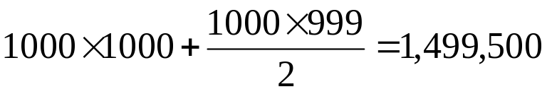
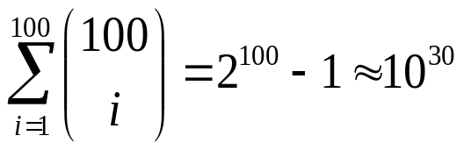
Bottlenecks of GSP
A huge set of candidates could be generated
  1,000 frequent length-1 sequences generate length-2 candidates!
Multiple scans of database in mining
Real challenge: mining long sequential patterns
  An exponential number of short candidates
  A length-100 sequential pattern needs 10³⁰ candidate sequences!

